Slide 1
Pocket money Проект подготовили ученицы коммунарской сош №1: Лютая Дарья и иванова Кристина

Slide 2
Plan
Where the word “dollar” came from
How to earn money in the internet
Questions
Conclusion

Slide 3
Where the word “dollar” came from
The word “dollar” has German origin and is much older than the USA and its currency! In 1516 in Bohemia, in a place called “Joachimsthal” a silver mine was opened, and they started to produce coins known as “Joachimsthalers”. This long word was soon shortened to “thalers” and called “dalers” by the Dutch. The English changed this word to “dollar” and began to use it when speaking of any large silver foreign coin. In North America, for instance, English settlers referred to the Spanish piece of eight reals as the “Spanish dollar”.

Slide 4
Where the word “dollar” came from
For several years after independence Americans didn’t have a currency of their own, they used whatever foreign coins they could get , Spanish dollars included . But they understood that a new nation needed its own currency . Thomas Jefferson strongly opposed using the English system . It was his idea to call American money ’’dollars’’, a word people were already familiar with . The dollar was officially declared the USA monetary unit in 1785

Slide 5
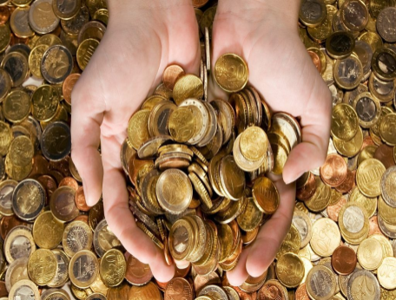
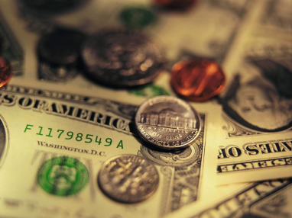
How to earn money
Now we will talk about the most common ways of earning money in the internet.

Slide 6
Get paid for downloading apps
Do you know about applications , that allow to get real money for downloading certain apps ? It doesn’t take a lot of time , but the payment usually doesn’t exceed 100 rubles a day . But money, earned this way should be enough to pay the bill for the internet or to buy small purchase

Slide 7
Writing articles
Writing articles is one of the most popular ways of earning money.
Types of articles:
1. News
2. Feature
3. Editorial
4. How-to
5. Profile
Teenagers who can write essays can earn from two hundred ( without experience and reputation )to eight hundred rubles per day ( after few weeks/months of writing articles )

Slide 8
Group in the VK
If you have a lot of free time you can create a group in the VK ( or any other social networks ). Firstly you have to develop your group for free , but then if you will be able to attract subscribers , you can sell an advertisement , and receive money

Slide 9
Make Money with Online Surveys
You can make money by completing small surveys which takes from 5 minutes to 20 minutes depending on the requirement of a particular company. You need to write your feedback and opinion in a survey. You just have to select your choice from the question and there is no need to write anything. You can make from $1 to $20 depending on the length of the survey, your profile and the country you are living in.

Slide 10
How to earn money

Slide 11
Questions

Slide 12
Questions

Slide 13
Questions

Slide 14
Questions

Slide 15
Questions

Slide 16
conclusion
Thank you for your attention. We hope that the information , presented in our project was new and interesting for you.

